Slide 1

CSC 3315
Languages & Compilers
Hamid Harroud
School of Science and Engineering,
Al Akhawayn University
h.harroud@aui.ma
Notes:
SENG697: Agent-based Software Engineering
2007 (Fall)
http://www.enel.ucalgary.ca/People/far/Lecture/SENG697/

Slide 2
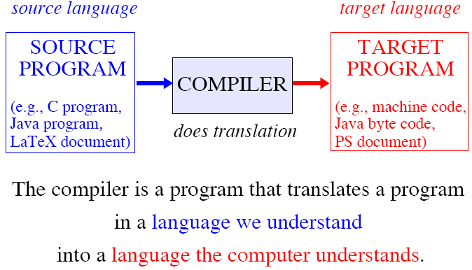

What is a Compiler?

Slide 3
Why Study Compilers?
To be more effective users of compilers ... Instead of treating a compiler as a “black box”.
To apply compiler techniques to typical SE tasks that require reading input and taking action.
To see how core CS courses fit together, giving you the knowledge to construct a compiler.
To participate in R&D of high-level programming languages and optimizing compilers.
Notes:
SENG697: Agent-based Software Engineering
2007 (Fall)
http://www.enel.ucalgary.ca/People/far/Lecture/SENG697/

Slide 4
What is a Language?
Language: Any system of formalized symbols, signs, gestures, used or conceived as a means of communicating thought, emotion, etc.
Examples: Natural languages, Mathematical notation, High-level programming languages, Assembly language
Languages vary widely in appearance, applicability, and complexity.
Grammars
Notes:
SENG697: Agent-based Software Engineering
2007 (Fall)
http://www.enel.ucalgary.ca/People/far/Lecture/SENG697/

Slide 5
Syntax & Semantics
Syntax: decides whether a sentence in a language is well-formed
√ The sun is shining. × Shining is the sun.
Semantics: determine the meaning, if any, of a syntactically well-formed sentence
√ I read a book. ? The house reads a book.
Notes:
SENG697: Agent-based Software Engineering
2007 (Fall)
http://www.enel.ucalgary.ca/People/far/Lecture/SENG697/

Slide 6
Syntax & Semantics
Syntax is easy:
  Well-understood.
  Good theory: regular and context-free languages and automata.
  Good tools, even for complex cases.
Semantics are hard:
  Inherently complex.
  Variety of choices:
    Operational — Definitional interpreter
    Axiomatic — Logic
    Denotational — Mathematical functions
  Few tools.
Notes:
SENG697: Agent-based Software Engineering
2007 (Fall)
http://www.enel.ucalgary.ca/People/far/Lecture/SENG697/

Slide 7
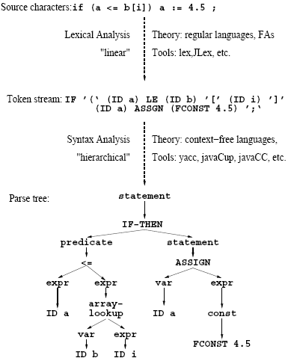
Example: Lexical & Syntax Analysis
Notes:
SENG697: Agent-based Software Engineering
2007 (Fall)
http://www.enel.ucalgary.ca/People/far/Lecture/SENG697/

Slide 8
Contents
Overview
Lexical Analysis; Grammars
Finite Automata; FLex
Syntactic analysis; Top-down parsing;
Recursive descent & LL(1) parsing
Bottom-up parsing; FLex
Programming Paradigms
Prolog, Scheme, XML, Python
Semantic Processing: Subprograms
Semantic Processing: Code Generation
Notes:
SENG697: Agent-based Software Engineering
2007 (Fall)
http://www.enel.ucalgary.ca/People/far/Lecture/SENG697/

Slide 9
Languages & Compilers
Textbook: Concepts of Programming Languages, Robert W. Sebesta, 11th ed., Addison-Wesley, 2016.
eMail : H.Harroud@aui.ma
Office : Room 201, Bldg 9
Office Hours : TR 9:00 - 13:00

